Slide 1

Git and Github (Version Control tool)

Slide 2

GIT
What is it GIT?
Where it is useful
Architecture
Terminology
Installation
Git Bash (Local Repository)
Command

Slide 3
What is it Git
Git is a distributed version control system that allows developers to track changes in their computer files and work in collaboration with other developers.
Git is a free and open source tool designed to handle everything from small to very large projects with speed and efficiency.
Git is a revision control system, a tool to manage your source code history.

Slide 4
Types of version control systems
Two types
Centralized version control systems
Distributed version control systems
Centralized version control systems :
It uses the central server to store all the files. It works on single repository to which users can access the single central sever.

Slide 5
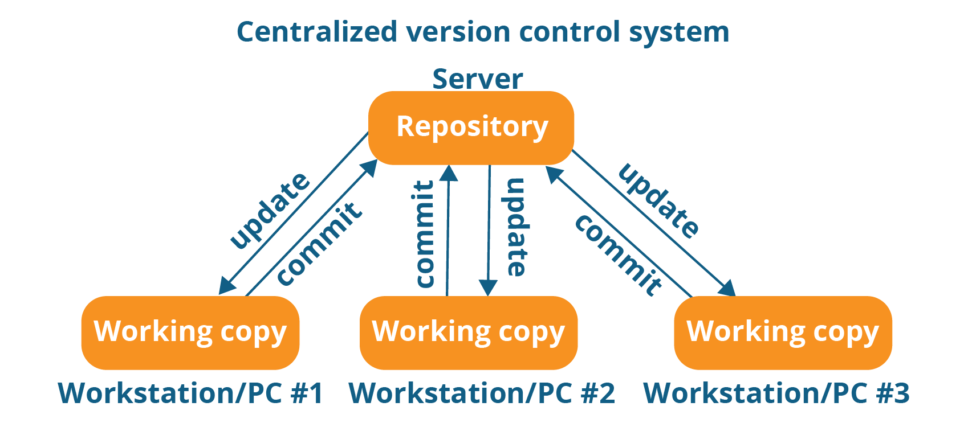
The central server that could be local or remote which is directly connected to each of the programmer’s workstation.

Slide 6
In this every programmer can add or update and commit their changes
Advantages :
1. Pretty convenient (because of single repository)
2. Every operation performed directly on repository
Disadvantages :
1. If the central server goes down or crash will lose the entire data

Slide 7
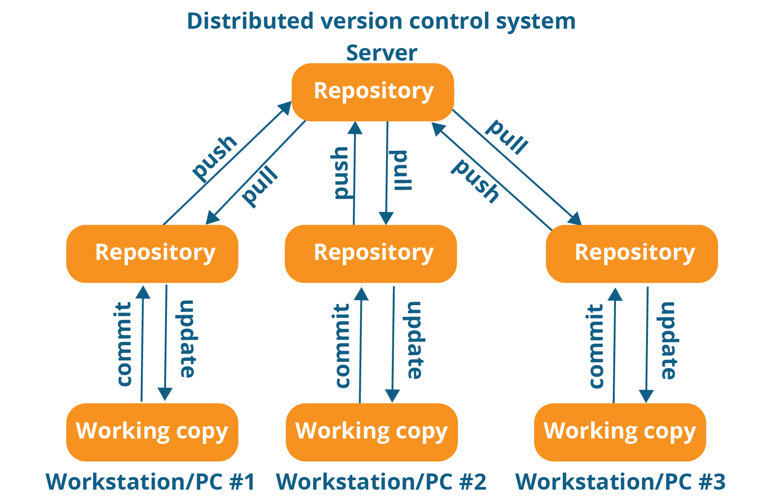
Distributed control system

Slide 8
Advantages of DCS
every programmer maintains a local repository on its own, which is actually the copy or clone of the central repository on their hard drive. They can commit and update their local repository without any interference.
Programmers can update their local repositories with new data from the central server by an operation called “pull” and affect changes to the main repository by an operation called “push” from their local repository.
Advantages :
High availability (the data will be available on local and remote repository)

Slide 9
Terminology
Git bash : It is a local repository
Git hub : It is a web-based Git repository hosting service
Tag : Repository name
Trunk : Production code
Branch : Copy of a code (use to create a other line development)
Master : production branches are called master branch
Merge: the changes from one branch (in the same repository or from a fork), and applies them into another
Ssh key : SSH keys to securely transfer information to your computer.
Pull : get the data from remote to local
Push : send the data from local to remote
Repository : storing data or storage
Clone : replica of repository

Slide 10
GIT installation on different os
Linux : $ yum install git
Linux (Debian or ubuntu ) : $ apt-get install git
Mac : https://git-scm.com/donwload/mac
Windows : https://git-scm.com/download/win
Official site :
https://git-scm.com/download
Above links are to download the git bash (local repository)

Slide 11
Git operations
The basic operations in Git are:
Initialize
Add
Commit
Pull
Push
Advanced Git operations are:
Branching
Merging
Rebasing

Slide 12
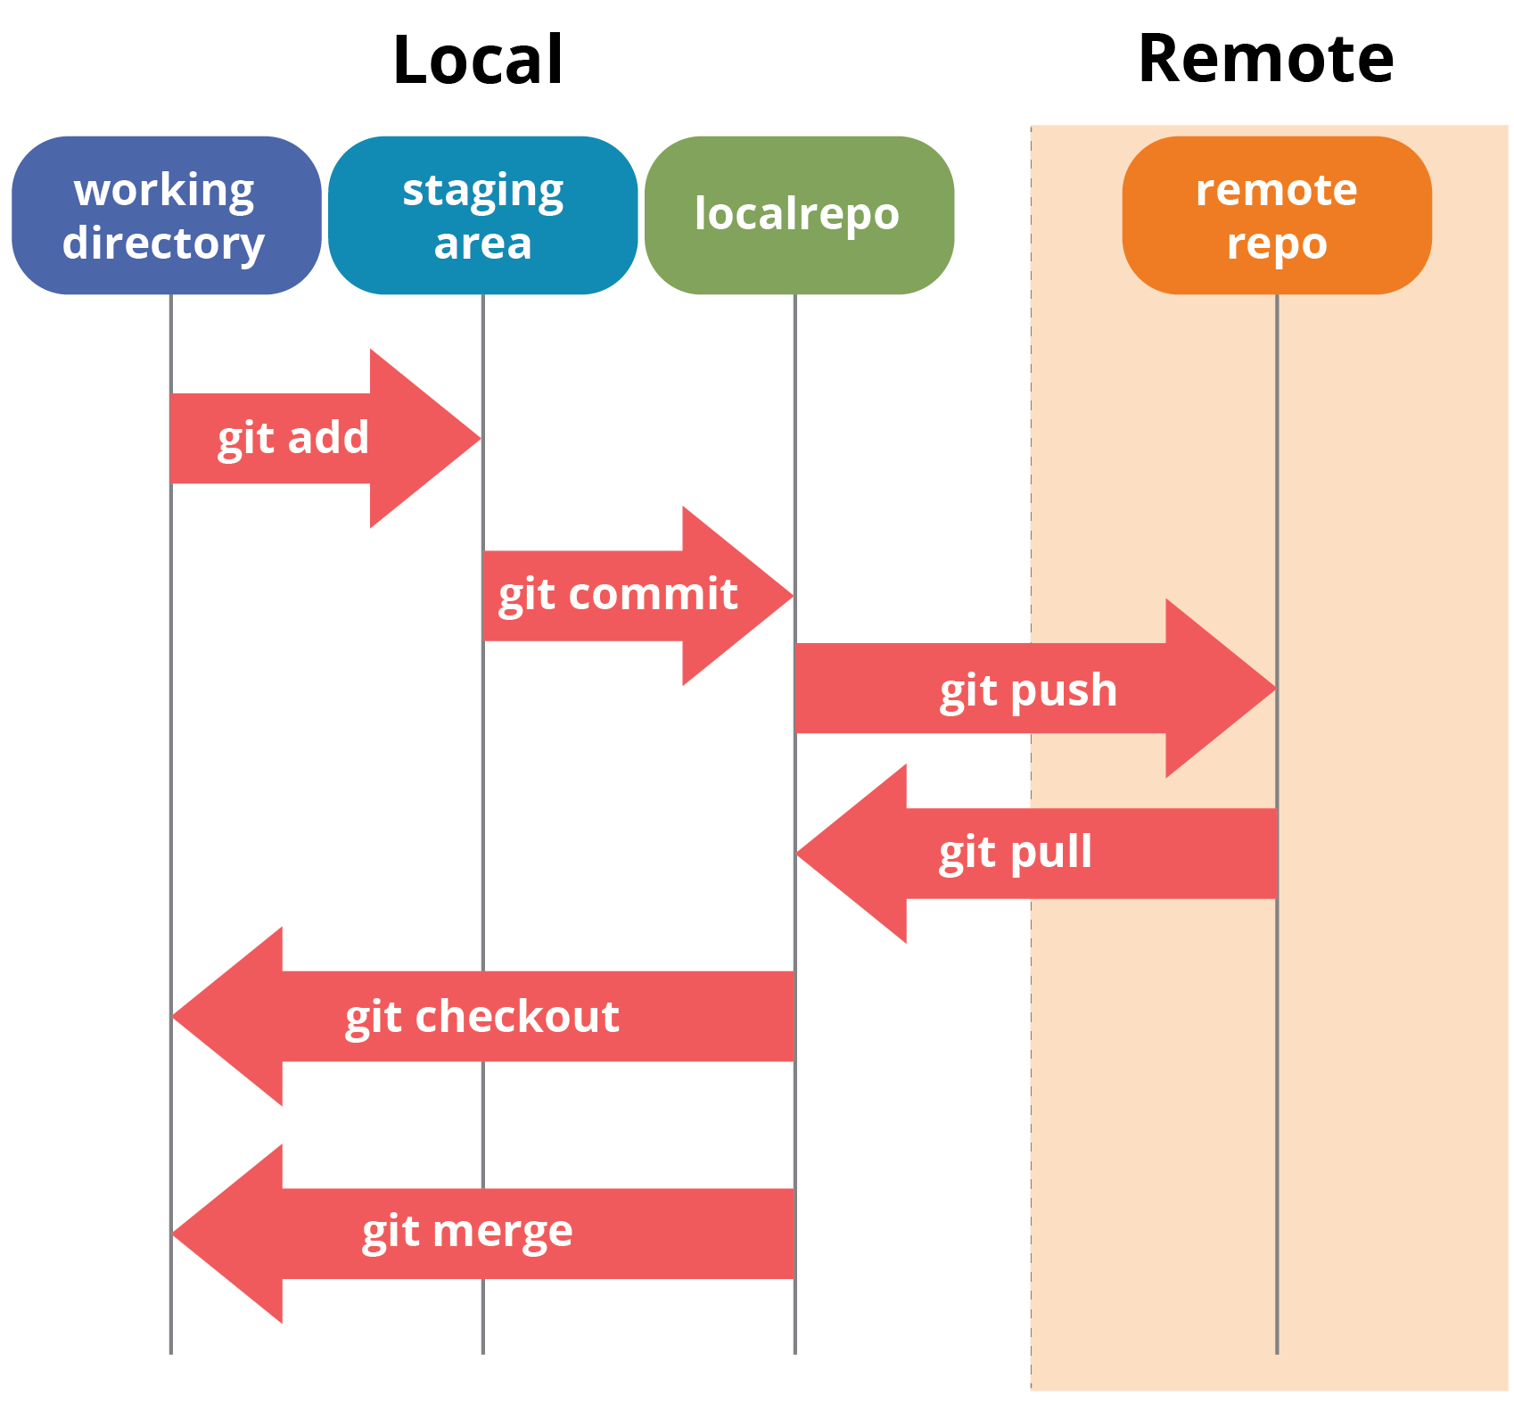
Workflow of Git

Slide 13
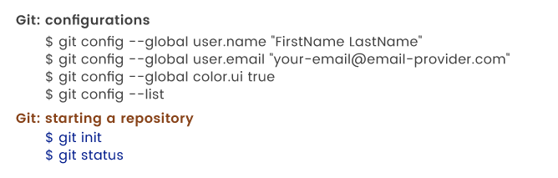
To start the git : git init

Slide 14
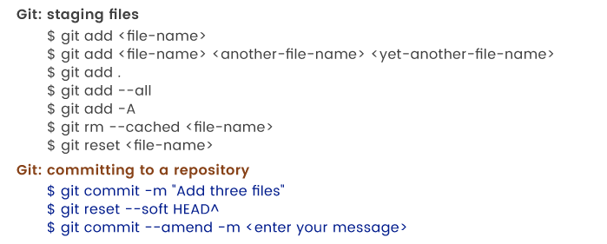
Adding file to staging area

Slide 15
Login to git hub
Git hub is the remote repository
Official site :
https://github.com/
Create username and password
Create repository (public and private)
Public : anyone can access (free)
Private : Based on permission (we need to pay)

Slide 16
Git bash
Login to git bash
$ git pull origin master
In git bash
$ git push <REMOTENAME> <LOCALBRANCHNAME>:<REMOTEBRANCHNAME>
Or else
**********************************************
In git bash create sshkey
$ssh keygen
The public and private key will be created

Slide 17
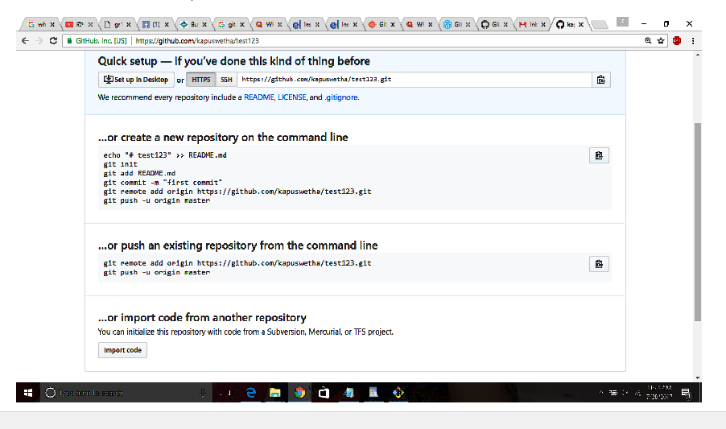
Git hub : repository

Slide 18
Git merge vs Git rebase
Git Merge:
Merge will seem like a fairly obvious thing, if you look at the end result. It is pretty much like taking two threads and tying them up in a knot.
Here the commit ‘b’, has the information regarding all the commits in feature1 and feature2. So, Merge preserves the history of the repository.
Git Rebase:
Rebase on the other hand doesn’t preserve the history. It quite literally re-bases one branch on top of the other i.e., it changes the base of the branch. Let’s see rebasing with the same example.
Let’s say I want to rebase feature1 onto feature2, what that means is that I want all the commits in the branch feature1 on top of the commits of feature2. So, after rebase your commit history would look like the following.
As you see in the picture, the base of feature1 which was previously the commit “a”, has been shifted to the green commit “4”. Hence the name Re-Base. Here feature1 is sitting on top of feature2 as opposed to being on “a”.

Slide 19
Git Operation
Let’s say we have two branches feature1 and feature2 that have diverged from a common commit “a” to have four commits each.
Now we want to combine both the features into a single branch. Merge and Rebase are our options. Let’s see what each of them can do.

Slide 20
Git operations
Git branch
Git merge
Git pull
Git push
Git fetch
Rebase
clone

Slide 21
Git Branch
It is a main branch for local repo.
It is a default branch
$ git branch
To display the number branches on local repository
$ git branch <branchname>
Ex : git branch DevENV
Screenshot has been attached in next slide

Slide 22
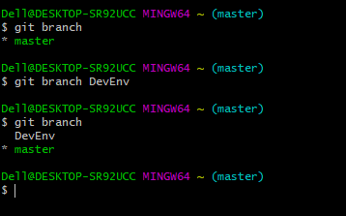
Note : (*) Symbol pointing to master branch by default

Slide 23
Git branch operations
$ git checkout <branch name>
To navigate to other branch
Ex : $ git checkout DevENV
when we checked git branch (*) Head can pointing to the Branch

Slide 24
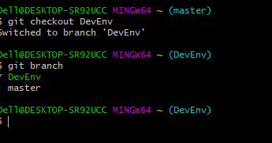

Slide 25
Git merge
Using this command we can combine the branches
$ git merge <branchname>
Ex : git merge DevEnv
DevEnv branch files will merge with master branch if we done this operation on master branch

Slide 26
Git branch operations
To delete the branch using below commands
$ git branch –d <branchname>
Ex : git branch –d DevEnv
$git log
Display all commit id’s

Slide 27
Git pull
It is combination git fetch and git merge command
Git fetch : download the commits from the remote branch
Git merge : integrate the branches
$ git pull origin
$ git pull (get the data from remote to local repo)

Slide 28
Git push
Pushing the code or data from local Repo to remote repo
$ git push <GitHub URL >
We can send the local repo code to remote repo

Slide 29
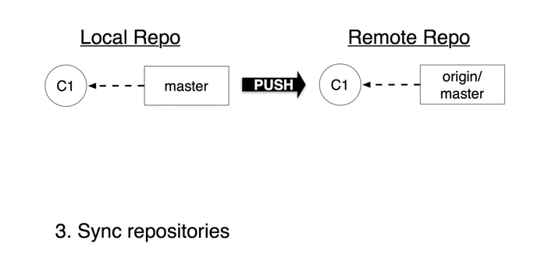
Git fetch

Slide 30
Git fetch
In local repo
$ git fetch orgin/master
The the commit will update but when we check $ git branch the “origin master “ wont be available on local
So we need to merge that
$ git merge origin/master

Slide 31
Git rebase

Slide 32
Git stash
Git stash temporarily shelves (or stashes) changes you’ve made to your working copy so you can work on something else, then come back and reply them later on.
Stashing is handy if you need to quickly switch context and work on some thing else, but you’re mid-way through a code change and aren’t quite ready to commit.
$ git status
On branch master Changes to be committed:
new file: style.css Changes not staged for commit:
modified: index.html
$ git stash
Saved working directory and index state WIP on master: 5002d47 our new homepage HEAD is now at 5002d47 our new homepage
$ git status
On branch master nothing to commit, working tree clean

Slide 33
Local repo and remote Repo communication
Pros:

Slide 34
Pros and cons of Github
Pros
Cons
Github makes for easier contributions to your top open source projects.
GitHub has everything turned into Markdown.
GitHub has some of the best documentation around.
GitHub has Gists and GitHub Pages, too.
The design of Git leans more towards the programmers – which means it may not communicate very well in layman’s terms. So basically, there’s a bit of a learning curve expected.

Slide 35
Basic commands
https://confluence.atlassian.com/bitbucketserver/basic-git-commands-776639767.html

Slide 36
Thank You.

